Slide 1


Slide 2

Give Us Clean Hands
We bow our hearts
We bend our knees
Oh Spirit come make us humble
We turn our eyes
From evil things
Oh Lord we cast down our idols

Slide 3
Give Us Clean Hands
So give us clean hands
and give us pure hearts
Let us not lift our souls to another (x2)
Oh God let this be
a generation that seeks
Who seeks Your face, Oh God of Jacob (x2)

Slide 4
Marvelous Light
Into marvelous light I'm running,
Out of darkness, out of shame.
By the cross you are the truth,
You are the life, you are the way

Slide 5
Marvelous Light
I once was fatherless,
a stranger with no hope;
Your kindness wakened me,
Awakened me, from my sleep
Your love it beckons deeply,
a call to come and die.
By grace now I will come
And take this life, take your life.

Slide 6
Marvelous Light
Sin has lost it's power,
death has lost it's sting.
From the grave you've risen
VICTORIOUSLY!

Slide 7
Marvelous Light
My dead heart now is beating,
My deepest stains now clean.
Your breath fills up my lungs.
Now I'm free. now I'm free! (x2)

Slide 8
Marvelous Light
Lift my hands and spin around,
See the light that I have found.
Oh the marvelous light
Marvelous light

Slide 9
The Stand
You stood before creation
Eternity within Your hand
You spoke the earth into motion
My soul now to stand
You stood before my failure
Carried the Cross for my shame
My sin weighed upon Your shoulders
My soul now to stand

Slide 10
The Stand
So what can I say
What can I do
But offer this heart O God
Completely to You
So I'll stand
With arms high and heart abandoned
In awe of the One who gave it all
So I'll stand
My soul Lord to You surrendered
All I am is Yours

Slide 11
The Stand
You stood before creation
Eternity within Your hand
You spoke the earth into motion
My soul now to stand
You stood before my failure
Carried the Cross for my shame
My sin weighed upon Your shoulders
My soul now to stand
So what can I say
What can I do
But offer this heart O God
Completely to You
So I'll walk upon salvation
Your Spirit alive in me
This life to declare Your promise
My soul now to stand
So what can I say
What can I do
But offer this heart O God
Completely to You
So I'll stand
With arms high and heart abandoned
In awe of the One who gave it all
So I'll stand
My soul Lord to You surrendered
All I am is Yours
Read more: http://artists.letssingit.com/hillsong-united-lyrics-the-stand-j3gh2sb#ixzz1V1fpMnD3
LetsSingIt - Your favorite Music Community

Slide 12
The War
Ephesians/에배소서/Efesios
6:10-24

Slide 13
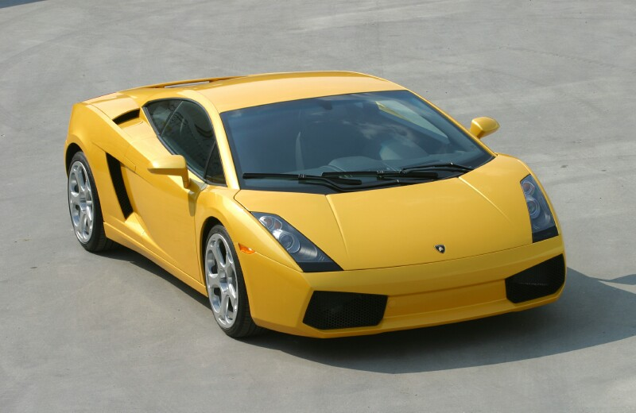
How many horses you got?
500 hp 0-100mph in 4.6 sec
0 + Lim x = Lim x
^{x->}∞
^{x->}∞
1 + Lim x =
0
^{x->}∞

